Slide 1



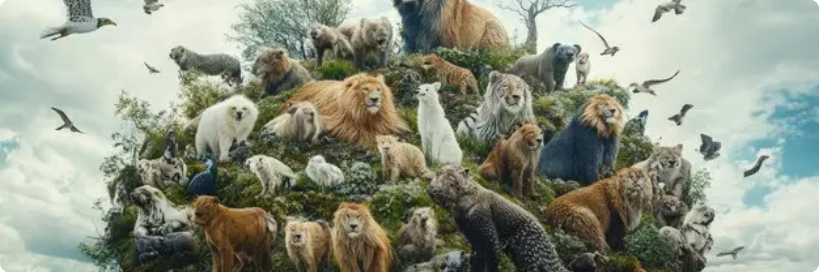







Image Classification & Object Detection System
Using Deep Learning, Transfer Learning, and HuggingFace Deployment
Computer Vision
Deep Learning
Transfer Learning
YOLO
HuggingFace
December 2025
Page 1/20

Slide 2











Team Members
Supervisor / Instructor
Ahmad Mostafa
Team Members
Roaa Mohamed Ahmed Nagieb
Mohamed Ramadan Fouad Mohamed
Ahmed Mohamed Hambuta
Youssef Hany Ezzat
Page 2/20

Slide 3













Presentation Timeline
Introduction
Overview of the image classification and object detection project.
Data Collection, Preprocessing & Exploration
Animals-10 dataset overview, 28,000 images across 10 animal classes.
Model Development
Image classification model with Transfer Learning, YOLO object detection.
Advanced Techniques & Deployment
Model Export with HuggingFace Spaces, Gradio User Interface.
MLOps, Monitoring & Web Interface
Version control with Git and DVC, Weights & Biases tracking.
Final Documentation & Conclusion
Final Results, Future Improvements, Project Conclusion.
Page 3/20

Slide 4








Project Overview & Core Technologies
Project Focus
Core Technologies
This project develops a robust, end-to-end system for both classifying images of animals and detecting their locations within those images.
Image Classification
Object Detection
Assigning predefined categories to entire input images, crucial for organizing large image datasets.
Identifying what objects are present in images and precisely locating them with bounding boxes.
Leveraging advanced Deep Learning techniques, specifically Transfer Learning, the system achieves high performance and is deployed on HuggingFace Spaces for accessibility.
Deep Learning
Transfer Learning
The culmination of this development provides an accessible and interactive platform for users to classify and detect animals in images.
Utilizing multi-layered neural networks to learn complex patterns directly from data for image analysis.
Reusing pre-trained models as starting points, reducing training time and improving performance.
HuggingFace Deployment
Platform for hosting and sharing machine learning models and interactive demos, making them accessible to a wider audience.
Page 4/20

Slide 5










Real-World Applications & Impact
Our image classification and object detection system has broad real-world applications across multiple industries, providing valuable solutions to various challenges.
Wildlife Monitoring
Autonomous Vehicles
Medical Imaging
Automated identification and tracking of animal species for conservation efforts.
Real-time detection of pedestrians, other vehicles, and traffic signs for safe navigation.
Assisting in the detection of anomalies or diseases in X-rays, MRIs, and other medical scans.
🐾
🚗
⚕️
Enables efficient wildlife tracking
Enhances driving safety
Supports diagnostic accuracy
Retail Inventory
Security Surveillance
Impact
Automatically counting and identifying products on shelves for efficient stock control.
Identifying suspicious activities or unauthorized objects in real-time video feeds.
Our system provides accessible and interactive platforms for various industries to leverage computer vision technology.
Increased efficiency
🛍️
Optimizes supply chain
🚨
Enhances security measures
Enhanced accuracy
Real-time insights
Page 5/20

Slide 6

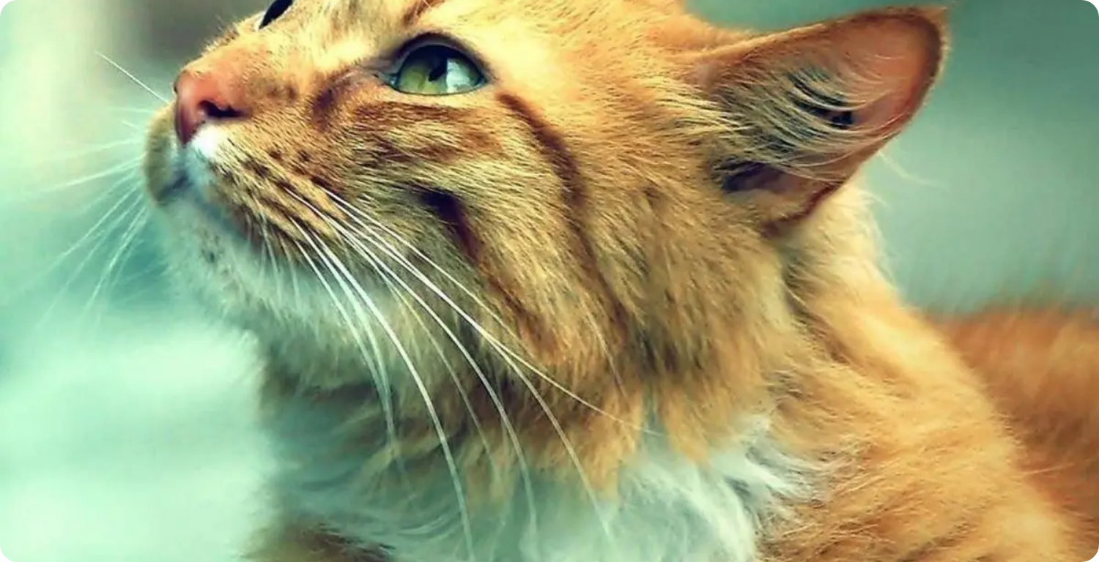














Animals-10 Dataset Overview
Dataset Highlights
Source: Kaggle's "Animals-10" collection
Size: Approximately 28,000 images
Classes: 10 distinct animal categories
Animals: Common species including dogs, cats, horses, and others
Dataset Purpose
Key Dataset Features
This comprehensive dataset serves as the foundation for both our image classification and object detection tasks, providing diverse animal imagery for model training, validation, and testing.
Diverse Perspectives
Visual Variety
Various angles and contexts
Different lighting conditions
Balanced Classes
Structured Format
For optimal model training
Ready for ML processing
Page 6/20

Slide 7








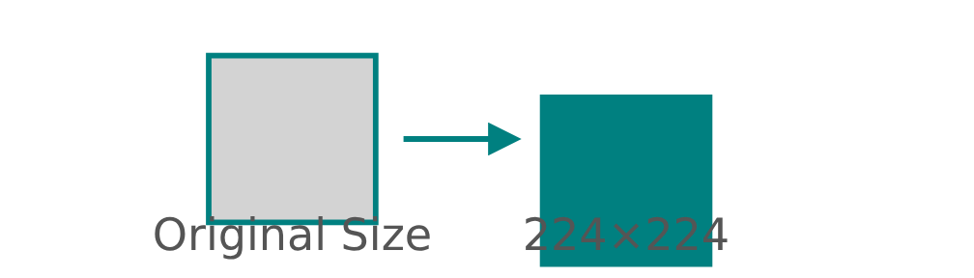
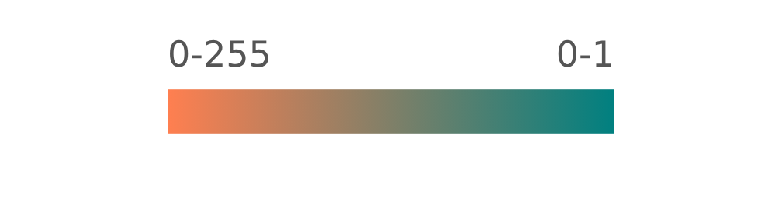




Data Preprocessing & Augmentation
Effective data preprocessing is crucial for training robust deep learning models. The following key steps were applied to the Animals-10 dataset:
Resizing
Normalization
Augmentation
All images were uniformly resized to 224×224 pixels, ensuring consistent input size for the neural network models.
Pixel values (0-255) were scaled to a normalized range [0, 1] or [-1, 1], stabilizing training and accelerating convergence.
Various techniques were applied to enhance dataset diversity and mitigate overfitting without collecting additional data.
Key Augmentation Techniques:
Random Rotations
Horizontal Flipping
Zooming
Page 7/20

Slide 8



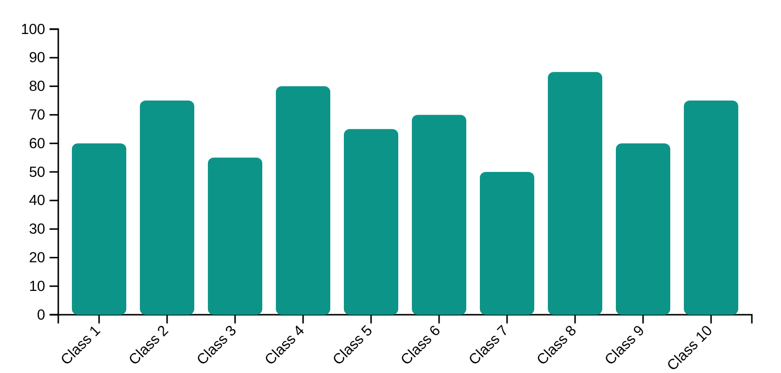













Exploratory Data Analysis & Dataset Splitting
Class Distribution Analysis
Dataset Splitting Strategy
A bar chart illustrating the distribution of images across the 10 animal classes to identify potential class imbalances.
The dataset was divided into training, validation, and testing sets using a stratified splitting strategy.
Stratified Splitting
80 – 10 - 10
Training Set
80%
Validation Set
10%
Test Set
10%
Used for final evaluation
Used to train the model
Used for hyperparameter tuning
Stratification ensures that the proportion of each animal class is maintained across all splits, preventing bias.
Stratified sampling ensures each class is represented proportionally across all splits.
Page 8/20

Slide 9















Image Classification Model Architecture
CNN Architecture with Transfer Learning
Key Architecture Features
Pre-trained on vast datasets like ImageNet
Custom Classification Head
Leverages knowledge from millions of diverse images
Input Images
Freezes convolutional base
Output Predictions
Retains powerful generic feature extraction capabilities
224×224×3
Dense Layers
Custom classification head
10 Animal Classes
Adapts the model for the specific 10-animal classification task
Feature Extraction
Significantly reduced training time
Pre-trained CNN Base
Accelerates development cycle for moderately sized datasets
Improved generalization
Enhances performance on related tasks with limited training data
Global Average Pooling
Page 9/20

Slide 10



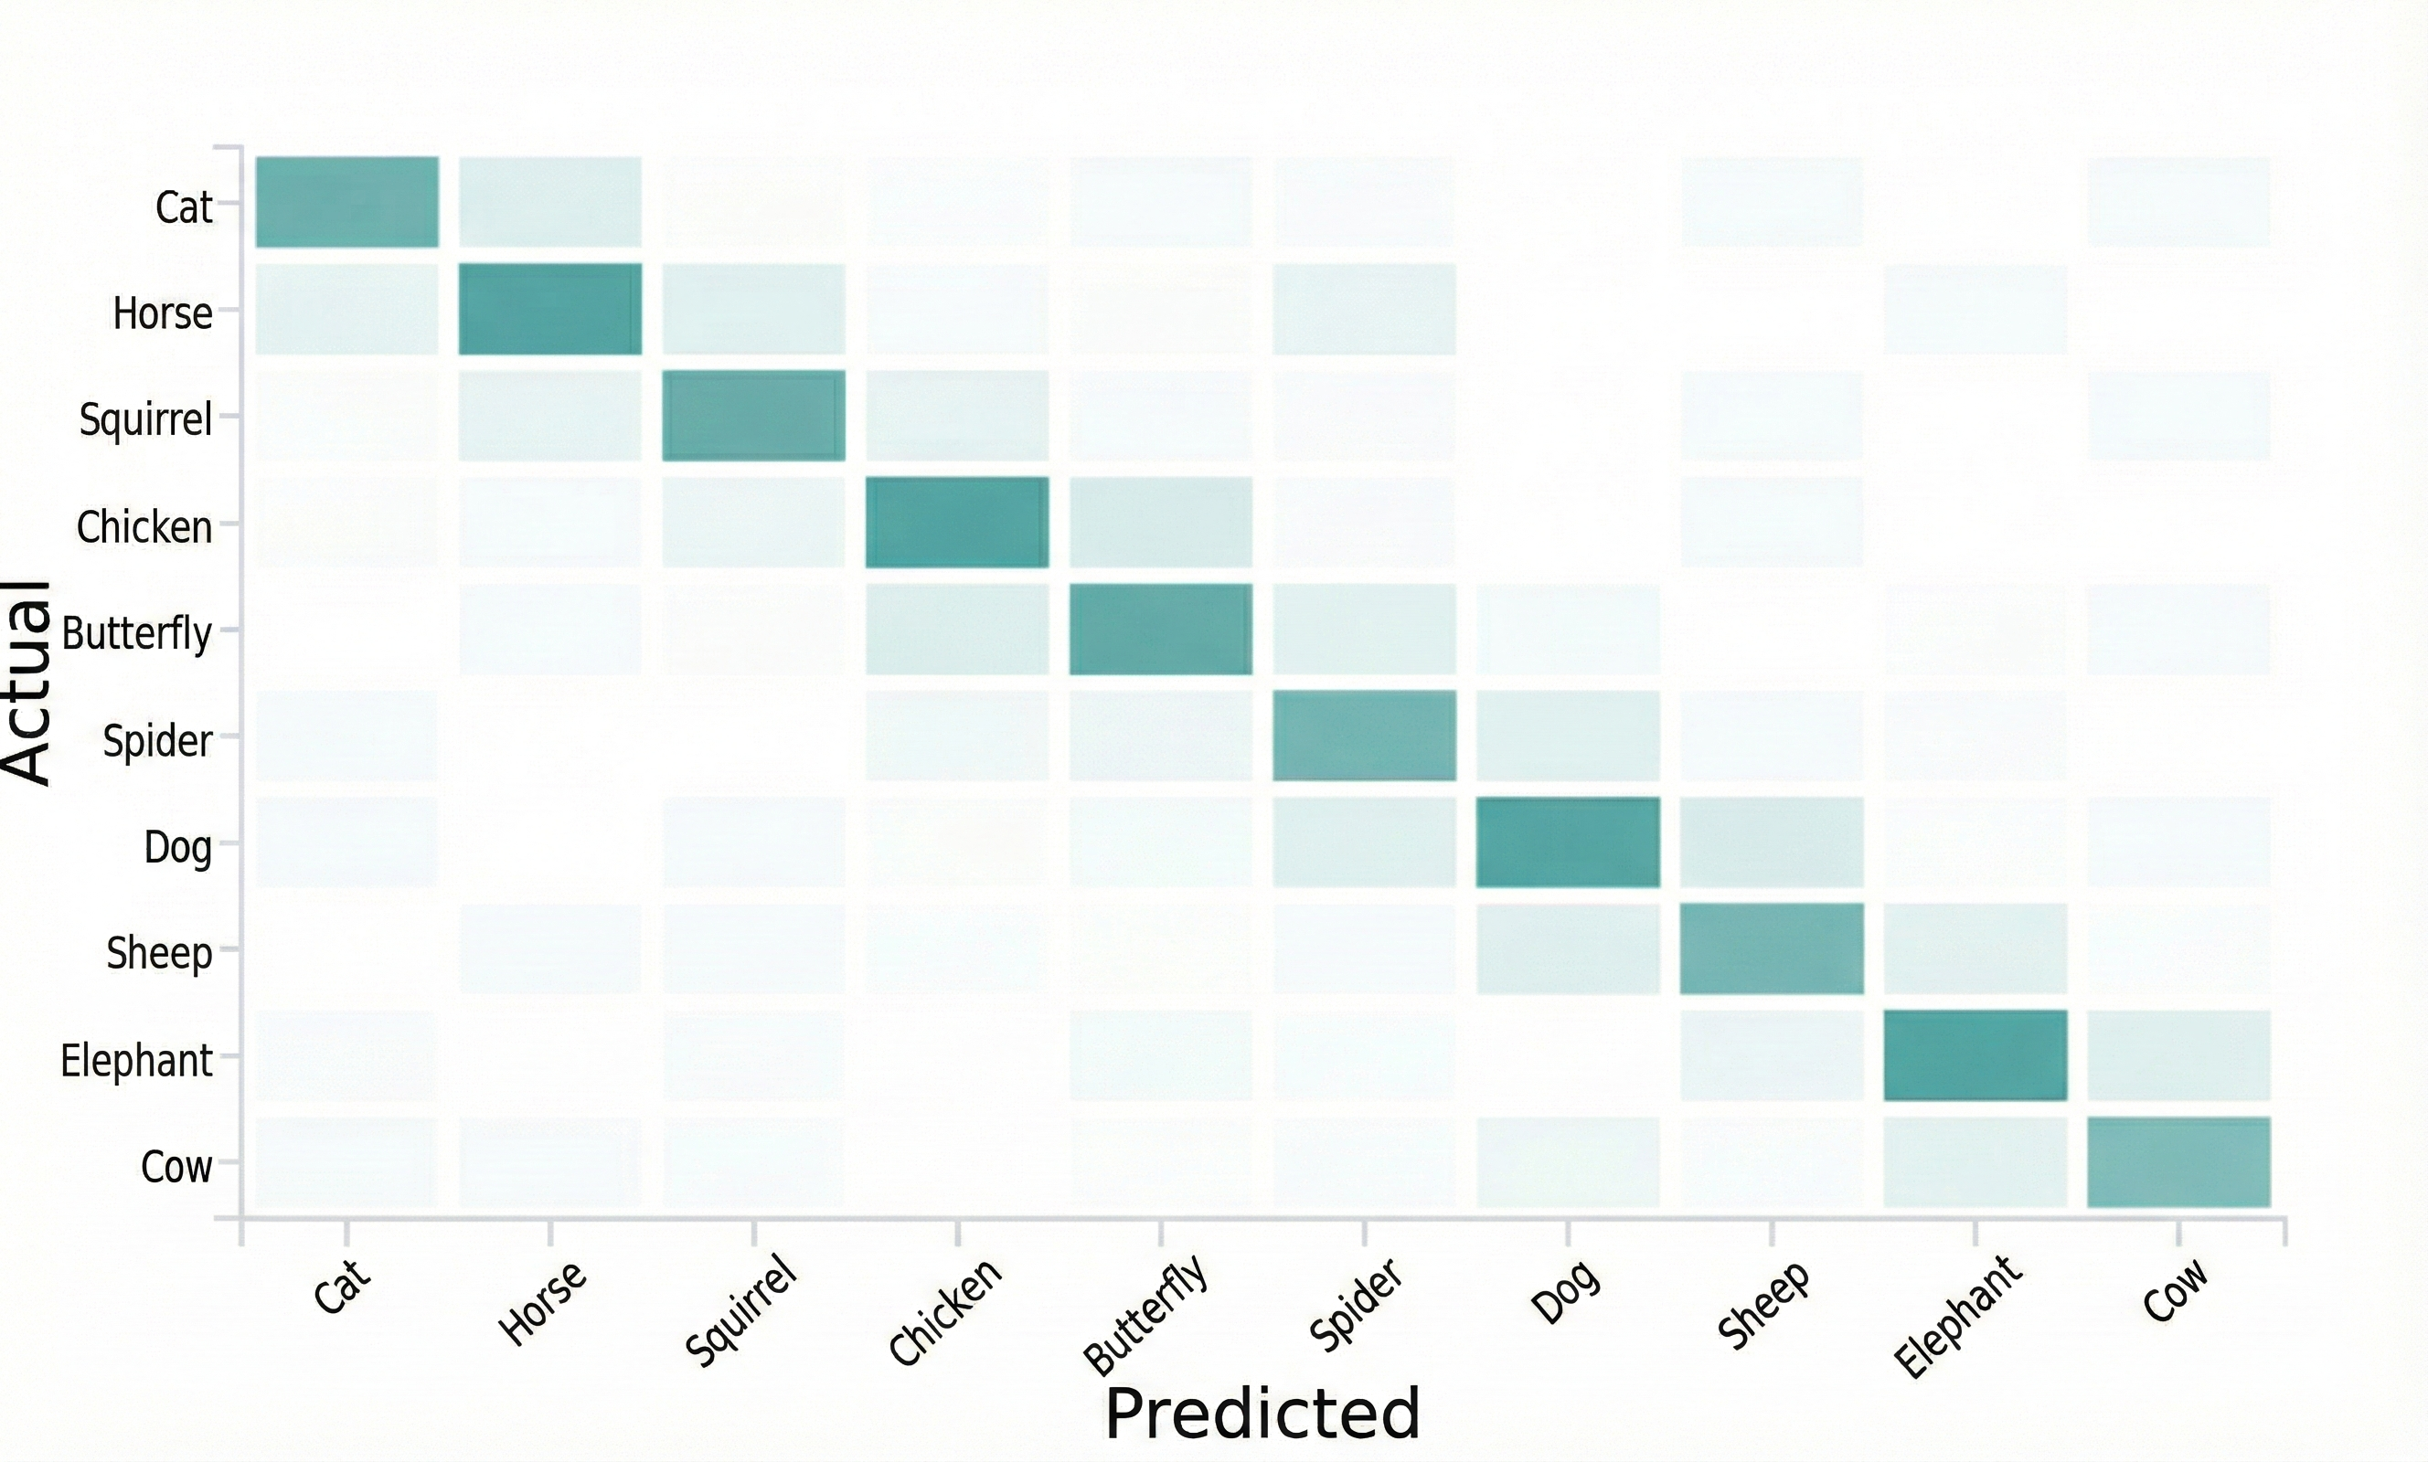





Classification Model Performance
Evaluation Metrics
Confusion Matrix
The classification model was evaluated using standard metrics to provide a comprehensive understanding of its performance:
The confusion matrix below illustrates the model's performance across all 10 animal classes:
Accuracy
Precision
Proportion of correctly classified instances out of total instances.
Proportion of true positive predictions among all positive predictions.
Recall
F1-Score
Proportion of true positive predictions among all actual positive instances.
Harmonic mean of precision and recall, providing balance between the two.
A confusion matrix was used to visualize the true positive, true negative, false positive, and false negative predictions for each class, offering insights into class-specific performance and potential misclassifications.
Page 10/20

Slide 11


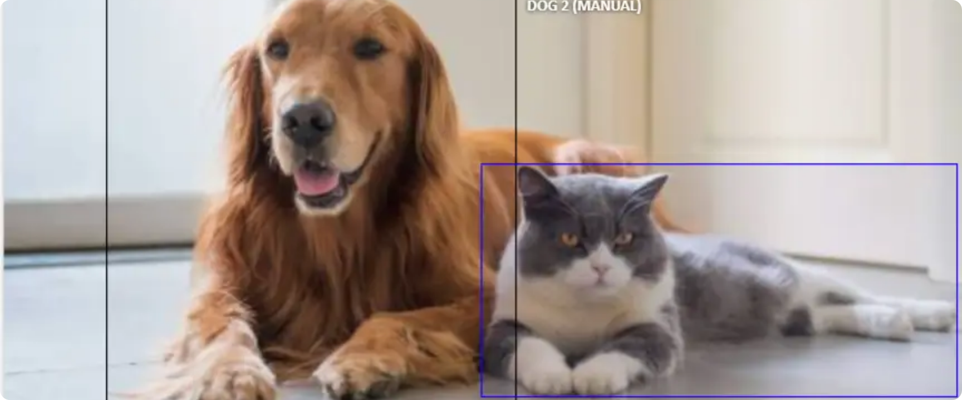














YOLO Object Detection Model
What is YOLO?
YOLO in Action
YOLO (You Only Look Once) is a real-time object detection model known for its efficiency and accuracy in predicting bounding boxes and class probabilities.
YOLO Detection Output
Real-time Processing
High Accuracy
Efficient single-pass detection
Precise localization and classification
Key Components
Grid Division
Image divided into grid for localization
Bounding Box Prediction
Training & Performance
Outputs coordinates and confidence
Class Prediction
Training Data
mAP & IoU
Predicts object class probabilities
Animals-10 dataset with annotations
Evaluation metrics for accuracy
Page 11/20

Slide 12





Object Detection Performance Metrics
The performance of the YOLO object detection model was assessed using key metrics that evaluate detection accuracy and localization precision.
Mean Average Precision (mAP)
Intersection over Union (IoU)
Overall measure of detection accuracy across classes
Quantifies overlap between predicted and ground truth boxes
Calculated at different IoU thresholds
Indicates localization precision of detections
Accounts for true positives and false positives
Calculated as intersection area divided by union area
mAP summarizes model performance across multiple classes and confidence thresholds.
IoU is a key metric for evaluating object localization accuracy.
IoU Visualization
Page 12/20

Slide 13















Transfer Learning Implementation
Implementation Process
Key Benefits
Reduced Training Time
Significantly accelerated development cycle by leveraging pre-learned features.
Pre-trained Model
Feature Extraction
InceptionResNetV2/VGG16
Frozen Convolutional Base
Improved Generalization
Model learned rich feature representations from millions of diverse images.
New Classification Head
Fine-tuned Model
Dense Layers
Adapted for Animals-10
Less Domain Data
Reduced need for vast amounts of domain-specific training data.
For the Animals-10 dataset, we utilized pre-trained models with ImageNet weights, freezing the convolutional base to retain powerful generic features while adapting the model for our specific classification task.
Page 13/20

Slide 14












Model Export & HuggingFace Deployment
Training
Export
Optimization
Deployment
Model architecture & weights
Save as deployable format
Prepare for inference
HuggingFace Spaces
Model Export
HuggingFace Deployment
Exported models into deployable formats
Deployed on HuggingFace Spaces platform
TensorFlow/Keras models saved as .h5 files
Streamlined environment for sharing ML demos
PyTorch models converted to ONNX format
Publicly accessible web interface
Optimized for inference efficiency
Real-time interaction with models
Key Benefit: Ensures consistent model behavior across different deployment environments
Key Benefit: Makes advanced ML capabilities accessible to non-technical users
Page 14/20

Slide 15





















Gradio User Interface Features
A user-friendly interface was developed using Gradio, facilitating seamless interaction with the deployed models. The interface incorporates several key features:
Image Upload for Classification
Interface Visualization
Users can easily upload an image file, which is then processed by the image classification model to predict the animal class with confidence score.
Animal Classifier & Detector
Navigation
Object Detection Functionality
Settings
Dog (87%)
A dedicated section allows users to upload an image for object detection. The system processes the image and overlays bounding boxes and class labels onto detected animals.
Camera Feed
Optional Camera Input
Cat (92%)
For real-time demonstrations, the interface includes an optional feature to utilize the device's camera, enabling live image capture for both classification and object detection tasks.
Upload Image
Use Camera
Page 15/20

Slide 16













MLOps Pipeline & Monitoring Strategy
Data Versioning
Code Versioning
Experiment Tracking
DVC for versioning datasets and model artifacts
Git for managing codebase and tracking changes
WandB for logging metrics and hyperparameters
Experiment Tracking & Versioning
Future Monitoring Strategy
Comprehensive tracking of metrics (accuracy, loss, mAP, IoU)
Performance Monitoring: Regular evaluation of model metrics on unseen data
Version control for codebase using Git
Data Version Control (DVC) for datasets and model artifacts
Data Drift Detection: Monitoring changes in data distribution
Scheduled Retraining: Automated pipeline for periodic model updates
The deployment on HuggingFace Spaces provides a live, publicly accessible web interface for real-time predictions.
Page 16/20

Slide 17

















Final Results & Performance Summary
Model Performance
Deployment Achievements
Model Type
Metric
Value
HuggingFace Deployment
Image Classification
Accuracy
High
Successful deployment of both models on HuggingFace Spaces
F1-Score
High
Gradio Interface
Object Detection
mAP
Strong
User-friendly interface with image classification and detection capabilities
IoU
Strong
Camera Integration
Optional camera input for real-time demonstrations and interactive experiences
Classification Accuracy
Detection Precision
High accuracy in correctly categorizing animal species across all classes.
Strong performance in localizing and identifying objects within images.
The live Gradio application provides an intuitive interface for users to interact with the deployed models, enabling both classification and object detection tasks.
Page 17/20

Slide 18





















Future Improvements & Roadmap
Model Optimization
Expanded Dataset
Advanced Architectures
Real-time Video Processing
Explainable AI (XAI)
Implement model quantization, pruning, or knowledge distillation to reduce size and inference latency.
Continuously expand training dataset with more diverse images and additional animal classes.
Explore newer deep learning architectures like Vision Transformers (ViT) for classification and advanced YOLO versions.
Extend object detection capabilities to process video streams in real-time for applications like live wildlife monitoring.
Incorporate XAI techniques to provide insights into model predictions, helping users understand why a particular classification was made.
Efficiency
Data
Application
Architecture
Transparency
Implementation Timeline
Current
Q2 2026
Q4 2026
Page 18/20

Slide 19







Project Conclusion & Key Achievements
Project Summary
Key Achievements
This project successfully developed and deployed a functional Image Classification and Object Detection System using Deep Learning and HuggingFace.
Robust Model Performance
Achieved high accuracy in both image classification and object detection tasks
By leveraging transfer learning and a robust MLOps pipeline, we created an accessible and efficient solution for identifying and localizing animals in images.
Transfer Learning Implementation
Successfully leveraged pre-trained models to achieve robust performance
HuggingFace Deployment
Deployed functional models on HuggingFace Spaces for accessible use
Key Insights
Modern AI techniques can be effectively deployed to real-world applications
Comprehensive MLOps Pipeline
Implemented monitoring and retraining strategies for model maintenance
Transfer learning enables robust performance even with moderately sized datasets
HuggingFace Spaces provides an accessible platform for ML model deployment
Page 19/20

Slide 20








Thank You!
We hope this presentation has provided a clear overview of our Image Classification & Object Detection System. Your support is greatly appreciated.
Questions?
We're happy to address any questions you may have about our system.
"Thank you for your time and attention. We hope to see you again!"
Project Date: December 2025
Page 20/20

